Slide 1
Salesforce Configuration Model – 2_1

Slide 2
AGENDA
Auto Response Rule
Escalation Rules
Approval Process
Workflow
Process Builder

Slide 3
Auto Response Rule
Business Scenario:
Imagine you are running an e-commerce business.
A potential customer fills out a contact form on your website, and they’re expecting a response.
But your customer service team is busy or the request comes in after working hours.
If the customer doesn’t hear back immediately, they might go to a competitor.
Solution:
Implement some automation that whenever a customer reaches out via email or a web form, they receive an instant automated response.
It helps maintain engagement with customers, even when your service team is unavailable.

Slide 4
Auto Response Rule
Introduction:
Automation tool that automatically sends responses through emails.
Auto Response Rules were introduced as part of Salesforce’s Sales Cloud & Service cloud to enhance Lead management & Case management.
Available for Lead and Case in Salesforce
There can be multiple auto response rules but only 1 is active at a time
Email responses can be tracked in the Activity History related list

Slide 5
Auto Response Rule
Why Is It Necessary?
Improves customer experience by sending immediate confirmation.
Prevents leads from going cold/unattended.
Allows your team to focus on high-priority tasks while still acknowledging customer inquiries.
Implementation Steps:
Navigate to Setup: Go to the Salesforce Setup and search for "Auto Response Rules."
Create New Rule: Click on "New" to create a rule for either leads or cases.
Define Criteria: Set criteria, such as the source of the lead or the case priority.
Assign Response Templates: Choose an email template that the customer will receive.
Activate the Rule: Make sure to activate the rule

Slide 6
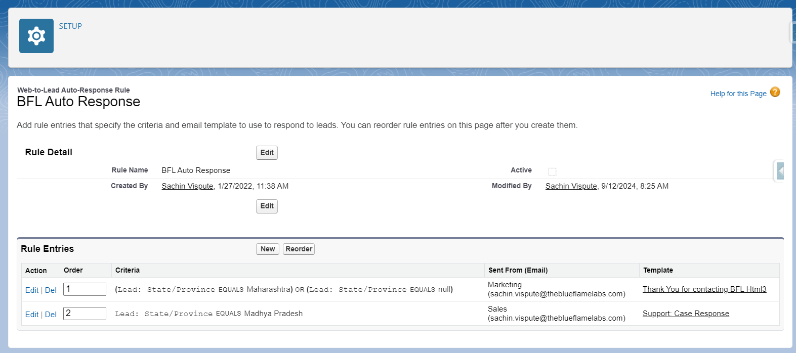
Example of Auto-Response Rules

Slide 7
Escalation Rules
Business Scenario:
A customer purchases a high-end smartphone from your E-Commerce platform, but after receiving the product, they notice that the phone is defective.
The customer immediately raises a support ticket with your customer service team, explaining the issue and requesting a replacement.
For the customer, the issue is urgent, as they have spent a significant amount of money and expect a quick resolution. However, your customer support team is overloaded with other requests, and the case might be overlooked or delayed.
The customer reports the issue via the platform’s support portal, and a case is automatically created in Salesforce. The customer expects a response within 4 hours, but no one has yet responded to the case.

Slide 8
Escalation Rules
Summary of Use Case:
Customer Expectations: The customer expects their defective mobile phone to be replaced or refunded quickly.
Risk of Escalation: If the issue is not resolved in a timely manner, the customer may leave negative reviews, demand compensation, or switch to a competitor.
Timely Escalation: Escalation ensures that urgent cases don’t get stuck at the lower levels of support, and higher authorities get involved before the situation escalates externally.

Slide 9
Escalation Rules
Solution:
First Escalation: If no one responds to the case within 4 hours, escalate the case to a Senior Customer Support Agent to ensure it gets immediate attention.
Second Escalation: After 8 hours, escalate the case to the Customer Support Manager for resolution, ensuring that a replacement or refund is initiated.
Final Escalation: If the issue persists beyond 8 hours, escalate to the Head of Operations / Director of Customer Support for critical action.

Slide 10
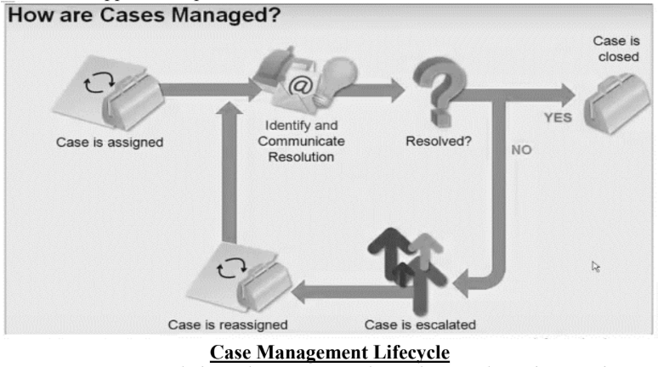
Escalation Rules

Slide 11
Escalation Rules
Introduction to Escalation Rules:
Escalation rule is an automation tool that automatically escalate cases to the next level of authority based on predefined conditions.
Escalation rules help ensure that cases are resolved within the expected time frame, particularly those that are high-priority or have not been addressed in a timely manner.
Available for Case object
Orgs typically use one escalation rule that consists of multiple rule entries
Objectives:
Ensures timely resolution of high-priority issues.
Prevent customer dissatisfaction by preventing unnecessary delays.
Allows for a structured approach to case resolution.

Slide 12
Structure of Escalation Rules
Escalation Rule
The escalation rule is the container for all rule entries and rule actions. Only one can be active at a time, and most organizations will only need to use one rule.
Escalation Rule Entry
When a case is created or modified, it will look to the list of rule entries for the first match. That rule entry will determine the case escalation actions. If no rule is matched, case escalation will not occur.
Escalation Actions
Each escalation rule can have many associated actions.

Slide 13
Create Escalation Rules
Implementation Steps:
Go to Setup: In Salesforce Setup, search for "Escalation Rules."
Create New Rule: Click "New" to define a rule for escalation based on case priority or time.
Define Criteria (Escalation Rule Entry) : Set criteria for escalation, such as "if a case is not resolved within 24 hours."
Assign Users (Escalation Actions): Specify who the case should escalate to, such as a supervisor or manager.
Activate the Rule: Test and activate the rule.

Slide 14
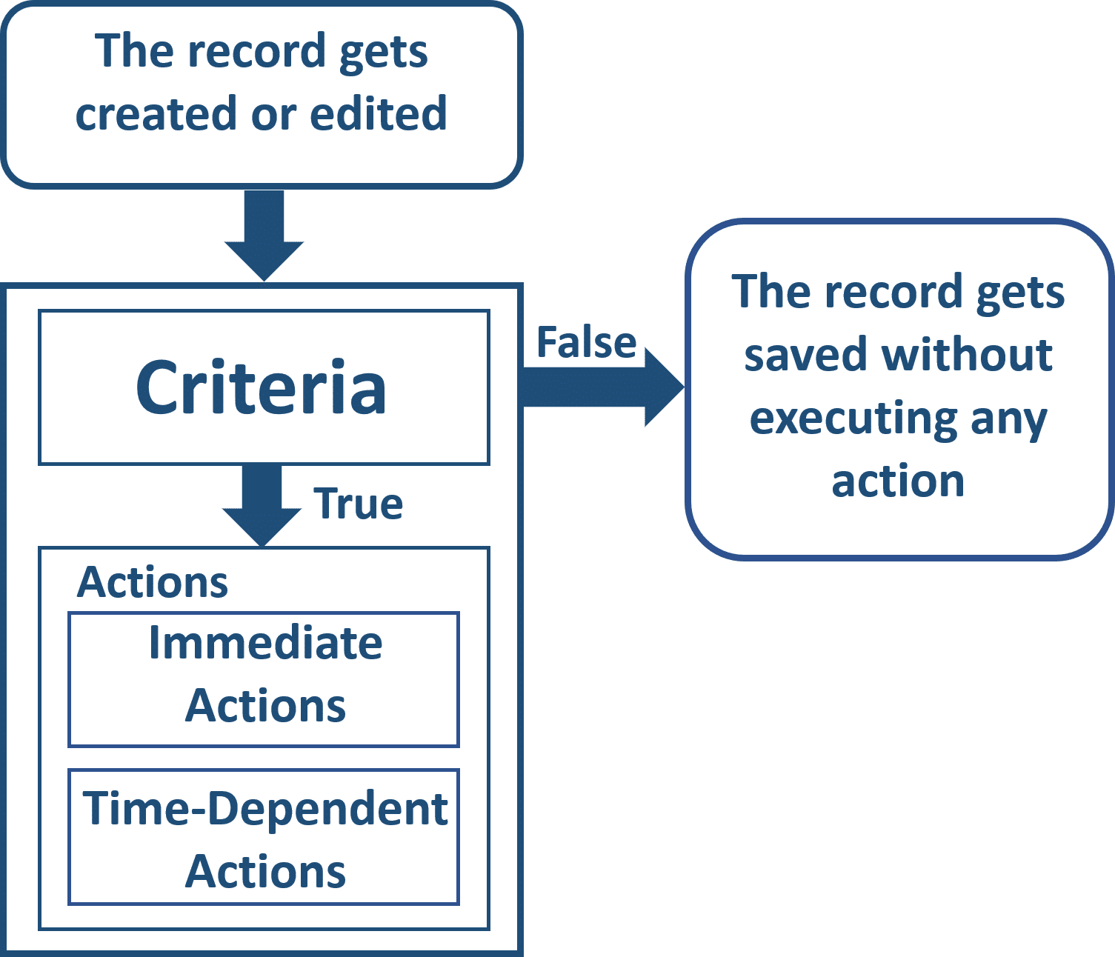
WorkFlow
Introduction:
Workflows are the automated processes that helps to perform actions like sending emails, creating tasks, updating fields, or sending outbound messages based on certain conditions automatically

Slide 15
Components of Workflow
Structure of Workflow:
1. Criteria: Criteria are conditions on basis of which the workflow will be invoked.
2. Actions: Actions occur after a record meets the criteria.
Immediate actions: Actions that get executed immediately when a record is created or edited
Time-dependent actions: Actions that get executed after a certain duration of time, such as 10 minutes after a record’s close date.
Available Actions:
1. Field updates (e.g., changing the status of an order).
2. Email alerts (e.g., notifying the customer or staff about order status).
3. Task creation (e.g., creating a task for the warehouse team to ship the product).
4. Outbound messages (e.g., sending order data to another system for shipping).

Slide 16
Components of Workflow
Evaluation criteria:
When a New Record is Created:
If a new order is created, and the order status is already set to "Shipped" at the time of creation, the workflow will fire immediately and send the shipping confirmation email.
When a Record is Edited:
Let’s say an order was created with the status "Processing." The workflow will not trigger yet, because the status does not meet the criteria ("Shipped").
Later, if the order status is updated to "Shipped," the workflow will trigger at this point, and the customer will receive the shipping confirmation email.
When a Record is Created and every time it’s edited to subsequently meet the criteria :
If the order status changes from "Shipped" to something else (e.g., "Out for Delivery"), and then changes back to "Shipped," the workflow will trigger again because the status newly meets the criteria after the edit.
However, if the status remains "Shipped" and other fields are edited (like the delivery address), the workflow will not trigger again, because the criteria were already met before the edit.

Slide 17
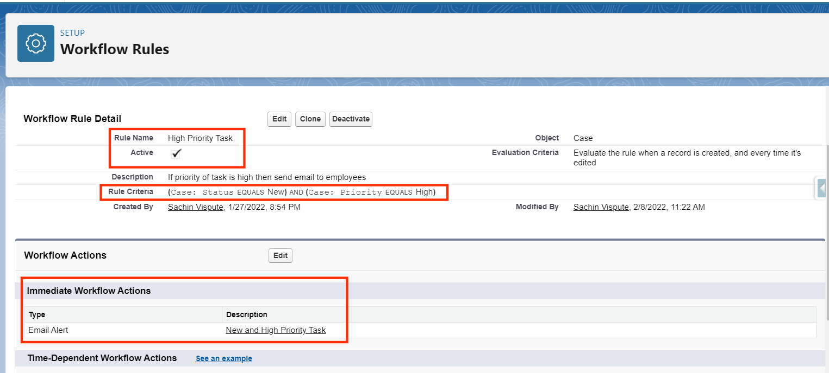
Workflow

Slide 18
Process Builder
Process Builder Salesforce is basically an automated tool that allows you to control the order of actions or evaluate the criteria for a record.
Process Builder supports three types of processes for your automation needs. The type determines what triggers the process.
a) A record change process starts when a record is created or updated.
b) An event process starts when a platform event message is received.
c) An invocable process starts when something else, like another process, invokes it.

Slide 19
Process Builder vs. Workflow
Use the more powerful and flexible Process Builder to perform the same actions as Workflow.
With Process Builder, you can:
Create a record of any object type
Update any related record—not just the record or its parent
Use a quick action to create a record, update a record, or log a call
Invoke a process from another process
Launch a flow—you can’t schedule this action with workflow
Send an email
Send a custom notification
Post to Chatter
Submit a record for approval

Slide 20
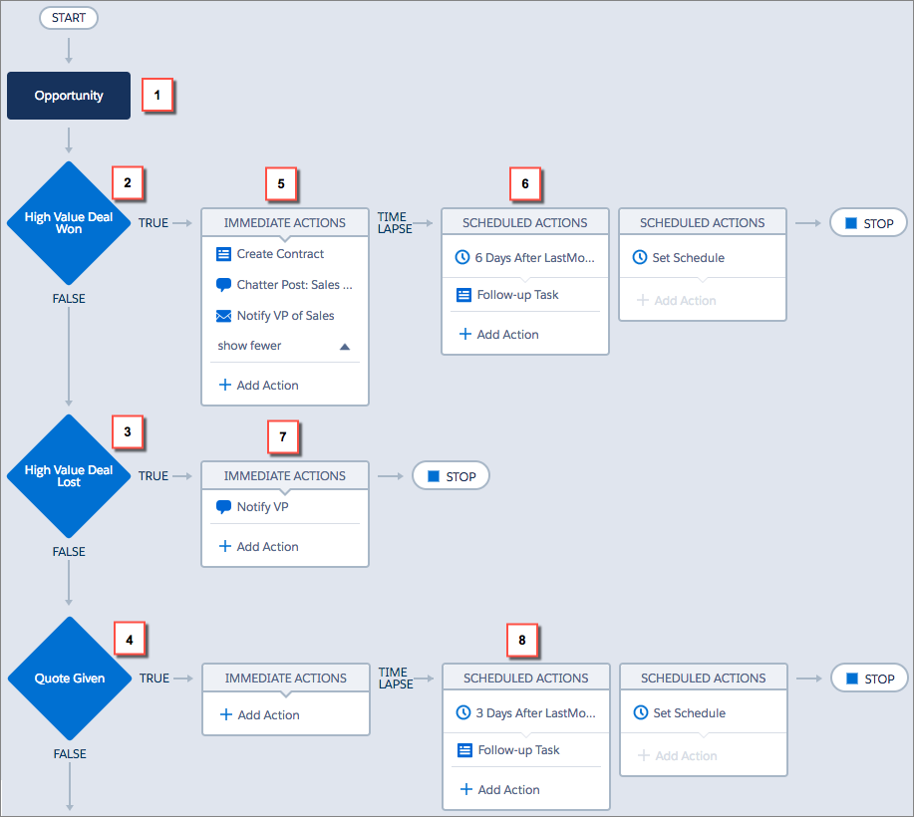
Example of Process Builder

Slide 21
Process Builder and Workflow Migration
Starting Summer'23 Process Builder and Workflows can no longer be created.

Slide 22
Approval Process
Approval Process in Salesforce is an automated process that automates how Salesforce records are approved in your org.
Approval Process in Salesforce is a combination of steps for a record to be approved/rejected either by a user, queue or public groups.
An approval process also specifies the actions to take when a record is approved, rejected, recalled, or first submitted for approval.
For example, when an employee creates a time-off request, have Salesforce automatically sends an approval request to the employee’s manager.

Slide 23
Approval Process
Make sure you preplan before you start configuring the Approval process in salesforce because this will help you design the approval process in the most optimized ways.
Preplanning includes of:
Creation of Required fields
Identify the object for the Approval process
Email Template
Final Approval Actions like unlock record or change the status of the record

Slide 24
Approval Process
Here is list of steps for approval process in salesforce :
Setup -> Create -> Workflow and Approval -> Approval Process
Select object for approval process to be written
Click on Create New Approval Process
Select Standard Setup Wizard from drop down
Enter the Process name, Unique Name and description for your process
Specify Entry criteria

Slide 25
Approval Process
Here is list of sections to be configured in salesforce approval process:
Process Definition Detail – Approval Process Header level details like name, email template etc.
Initial Submission Actions – It will be executed when the user clicks on ‘Submit for Approval’ on the object record.
Approval Steps – Details of Steps criteria and the approvers
Final Approval Actions – It will be executed after all the approval process steps have been approved.
Final Rejection Actions – It will be executed if one of the approval process steps have been rejected.
Recall Actions – It will be executed if one of the approval process steps have been recalled.

Slide 26
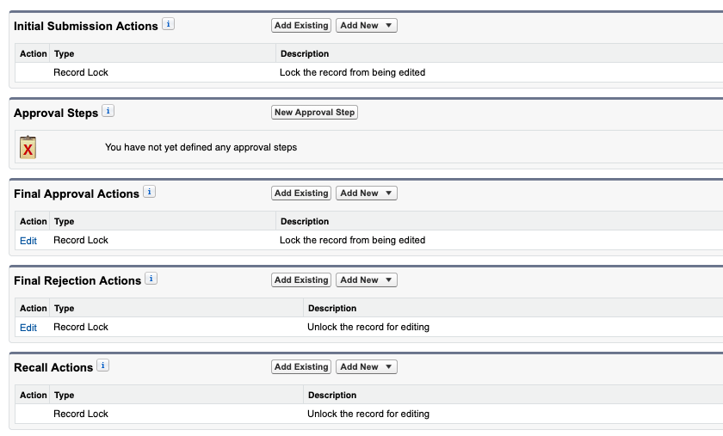
Approval Process

Slide 27
Thank You

